Slide 1
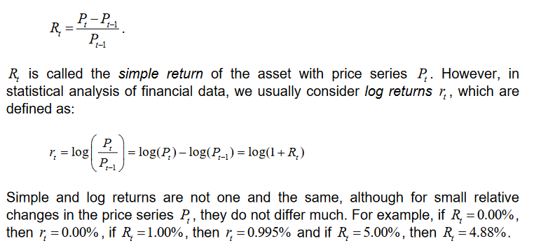
Return

Slide 2
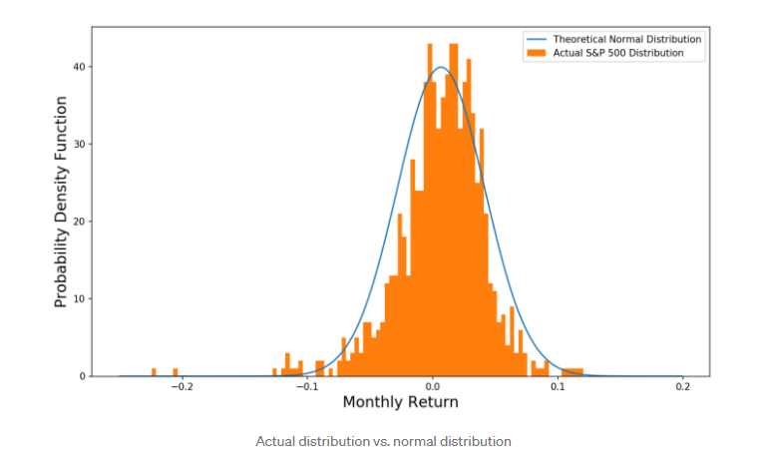
Normality in Financial Variables (A very strong Assumption)

Slide 3
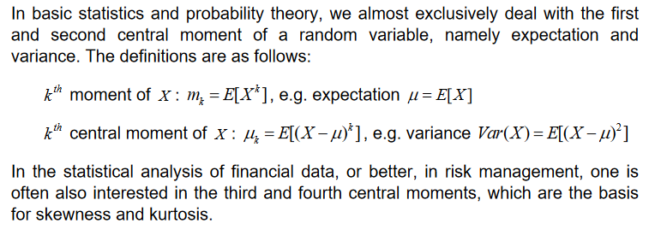
Deviation from Normalcy

Slide 4
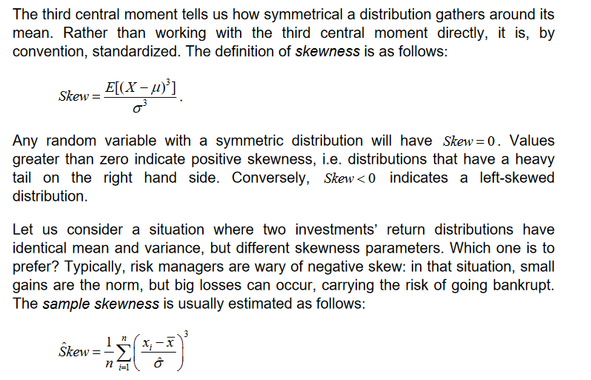
Skewness

Slide 5
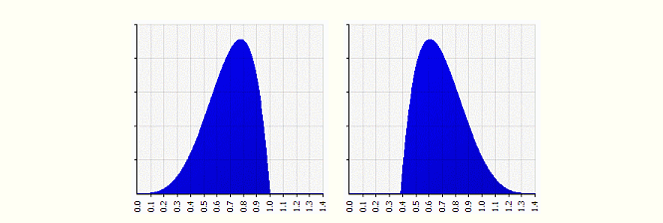
Skewness

Slide 6
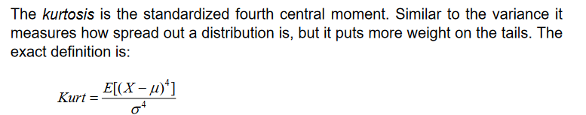
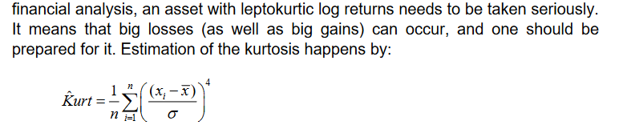
Kurtosis

Slide 7
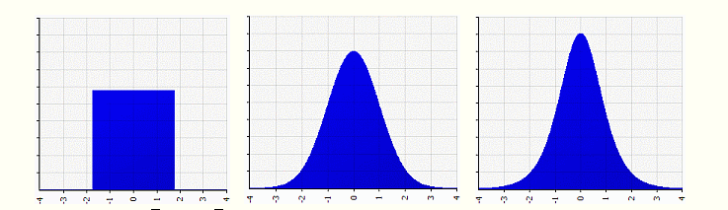
Kurtosis

Slide 8
Hypothesis Testing
One ‘ordinary” sample---> Inference about population
One ‘properly chosen’ sample is a good representative--→ Inference about population

Slide 9
Null and Alternative Hypothesis
A null hypothesis is a statement of the status quo or no effect. (H0)
An alternative hypothesis is one in which some difference or effect is expected. H1

Slide 10
Concept of ‘p-value’
P-value answer the question: What is the probability of the observed test statistic … when H₀ is true?
Thus, smaller and smaller P-values provide stronger and stronger evidence against H₀
Small P-value ⇒ strong evidence
Examples
P =.27 ⇒ non-significant evidence against H₀
P =.01 ⇒ highly significant evidence against H₀
Benchmark value= 0.05 (5% level of significance)

Slide 11
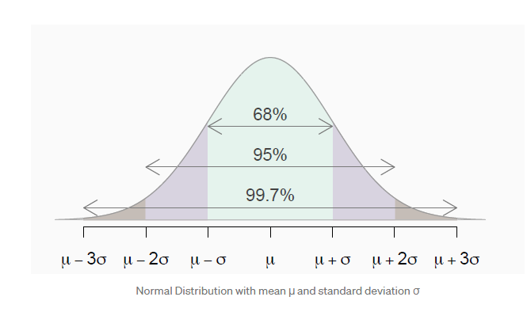
Normal Distribution

Slide 12
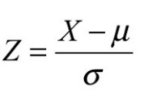
Z-statistic

Slide 13
Type of Errors in estimation
Type-I error (You reject a true null hypothesis)
You punish a person who is not guilty!
Type-II error (You accept a false null hypothesis)
You release a truly guilty person!

Slide 14
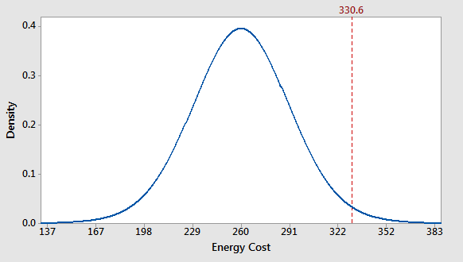
Level of Significance in a test

Slide 15
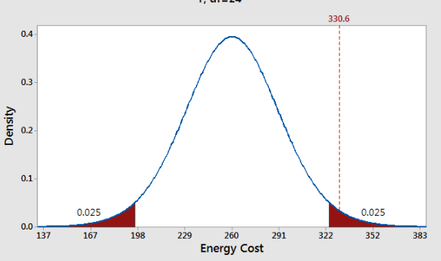
Two tail test

Slide 16
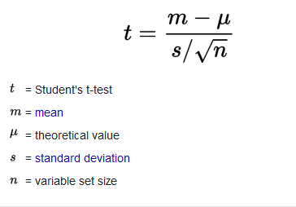
t-test statistic

Slide 17
2-t rule of thumb
If the sample size is more than or equal to 20 (n>=20) and level of significance is 5% then an absolute value of 2 (|t|>=2) will suffice to reject the null hypothesis.

Slide 18
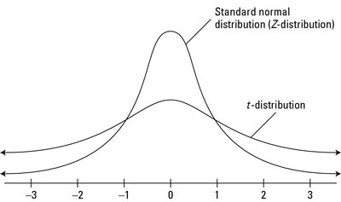
t-distribution

Slide 19
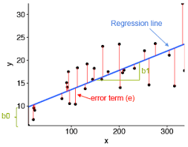
Notion of linear model (Regression) y= b0+b1*x

Slide 20
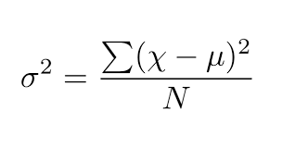
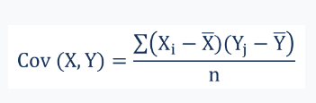
Variance and covariance

Slide 21





Derivation

Slide 22
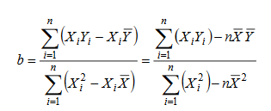
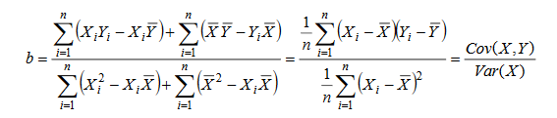
Cont..

Slide 23
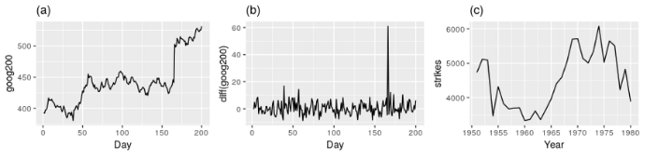
Time Series

Slide 24
Stationarity (3 properties)
Mean is constant
Variance is finite and time independent
Auto-covariance is constant and time independent

